Slide 1
https://go.boarddocs.com/ca/sandi/Board.nsf/files/C797R4004A4C/$file/Vaccine%20Mandate%20Plan.pdf

Slide 2
https://go.boarddocs.com/ca/sandi/Board.nsf/files/C797R4004A4C/$file/Vaccine%20Mandate%20Plan.pdf

Slide 3
Per the PREP Act:
3. Are There Any Limitation on Immunity from Liability?
WILLFUL MISCONDUCT* is misconduct that is greater than any form of recklessness or negligence. It is defined in the PREP Act as an act or failure to act that is taken:
· intentionally to achieve a wrongful purpose;
· knowingly without legal or factual justification; and
· in disregard of a known or obvious risk that is so great as to make it highly probable that the harm will outweigh the benefit
*All three of these conditions must be proven with clear and convincing evidence.
WILLFUL MISCONDUCT cannot be found against:
· A manufacturer or distributor for actions regulated by HHS under the Public Health Service Act or the Federal Food, Drug and Cosmetic Act, if HHS chooses not to take an enforcement action against the manufacturer or distributor, or if HHS terminates or settles an enforcement action without imposing a criminal, civil, or administrative penalty; or
· A program planner or qualified person who acts in accordance with applicable directions, guidelines, or recommendations issued by the HHS regarding administration and use of a countermeasure as long as HHS or the State or local health authority is notified about the serious injury or death within seven days of its discovery.
https://www.phe.gov/Preparedness/legal/prepact/Pages/prepqa.aspx#immune3

Slide 4
1
Pfizer/COMIRNATY FDA Approval Letter Vaccine BNT162b
https://www.fda.gov/media/151710/download
Per 21 USC 505 (o). VAERS is insufficient and incapable of quantifying the risk of serious adverse events (SAEs) and deaths from COMIRNATY. The data gathered so far merits several long-term follow-up studies, including six (6) myocarditis/pericarditis studies.

Slide 5
1
Pfizer/COMIRNATY Post-FDA Approval Studies
https://www.fda.gov/media/151710/download
“A major problem with protein-based therapeutics is their immunogenicity, that is, their tendency to trigger an unwanted immune response against themselves...
Such antibodies can cause complications that can be life threatening.”
https://www.fda.gov/vaccines-blood-biologics/biologics-research-projects/immunogenicity-protein-based-therapeutics

Slide 6
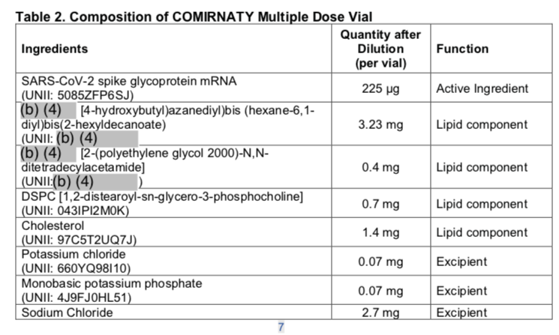
COMIRNATY Biological License Approval (BLA) – Ingredients, pgs 7-8
https://www.fda.gov/media/151733/download

Slide 7
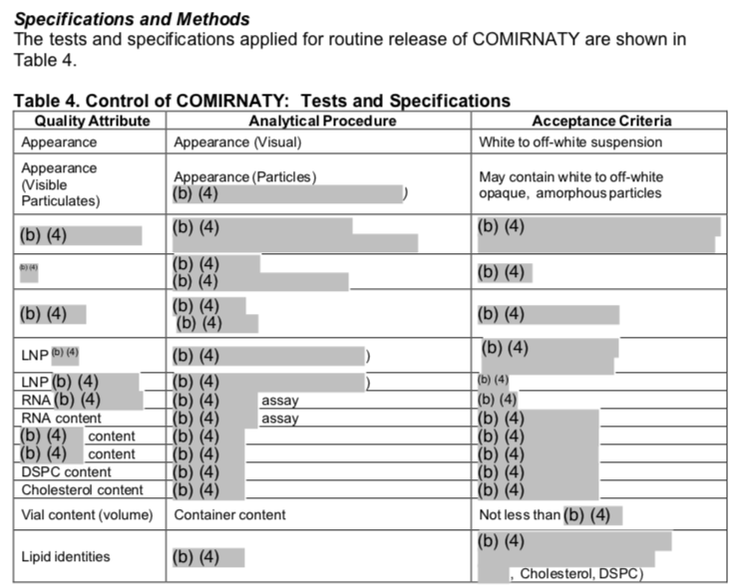
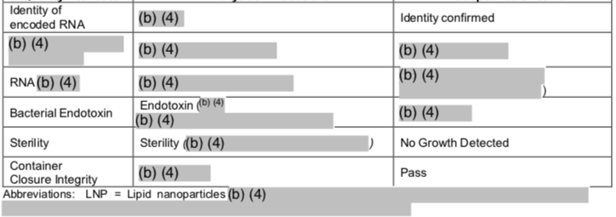
COMIRNATY Biological License Approval (BLA) –, pgs 10-11,
https://www.fda.gov/media/151733/download

Slide 8
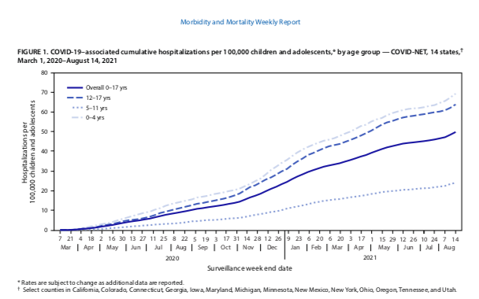
As mass vaccination increases, so do hospitalizations of child teens, children and babies from ‘COVID-19’
EUA Vax 12-15 years
EUA Vax Adults
https://www.cdc.gov/mmwr/volumes/70/wr/pdfs/mm7036e2-H.pdf

