Slide 1
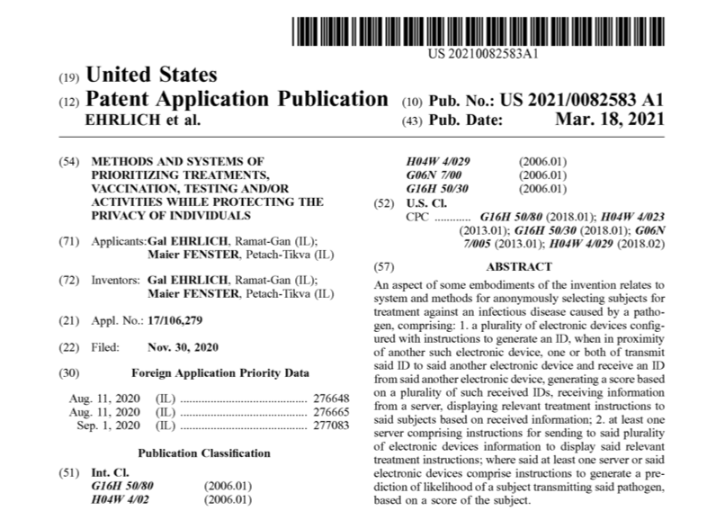
https://patentimages.storage.googleapis.com/04/24/12/7c8e8238f4ae9d/US20210082583A1.pdf

Slide 2
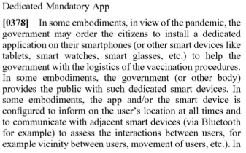
https://patentimages.storage.googleapis.com/04/24/12/7c8e8238f4ae9d/US20210082583A1.pdf

Slide 3
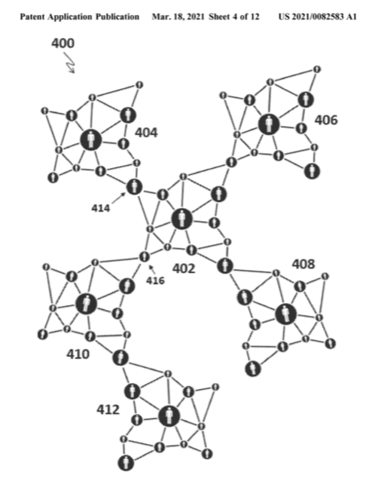
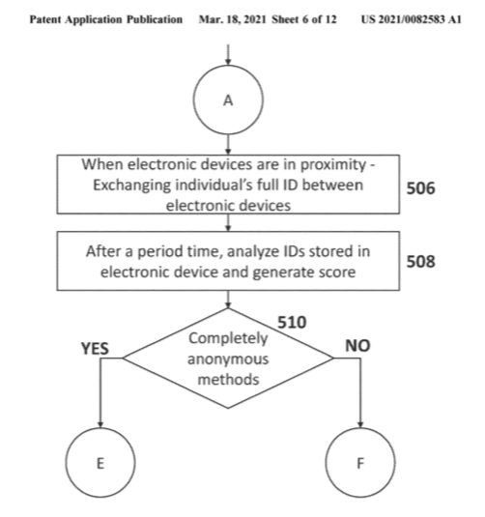
https://patentimages.storage.googleapis.com/04/24/12/7c8e8238f4ae9d/US20210082583A1.pdf

Slide 4
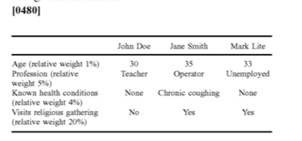
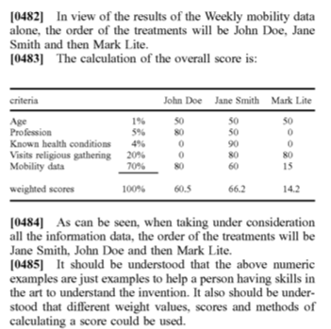
https://patentimages.storage.googleapis.com/04/24/12/7c8e8238f4ae9d/US20210082583A1.pdf

Slide 5
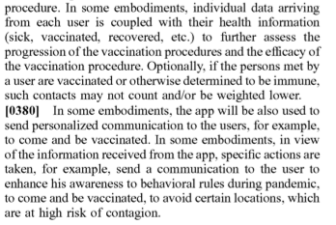
“…send a communication to the user to enhance his awareness to behavioral rules during pandemic, to come and be vaccinated, to avoid certain locations, which are at high risk of contagion.”
https://patentimages.storage.googleapis.com/04/24/12/7c8e8238f4ae9d/US20210082583A1.pdf

Slide 6

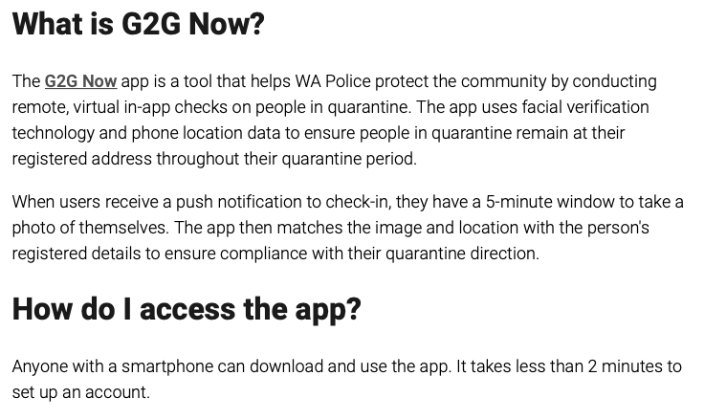
https://www.wa.gov.au/organisation/department-of-the-premier-and-cabinet/covid-19-coronavirus-g2g-now-frequently-asked-questions?fbclid=IwAR0WgFPfdYcclGzXmIzJYBn5G49lYLuhYPeo76V9byWuOFNFDKrz3nZm3oc

Slide 7
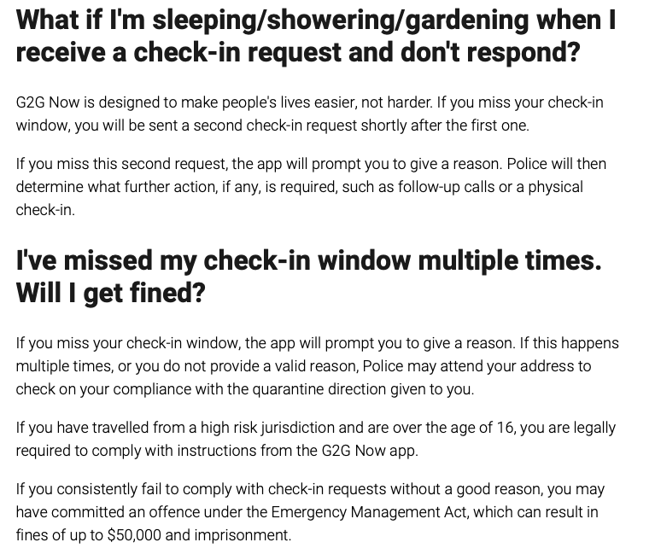
https://www.wa.gov.au/organisation/department-of-the-premier-and-cabinet/covid-19-coronavirus-g2g-now-frequently-asked-questions?fbclid=IwAR0WgFPfdYcclGzXmIzJYBn5G49lYLuhYPeo76V9byWuOFNFDKrz3nZm3oc

Slide 8
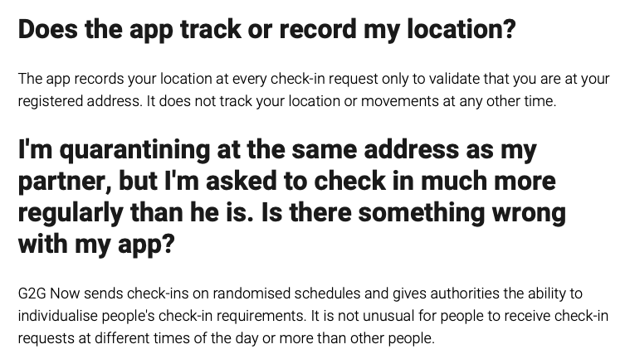
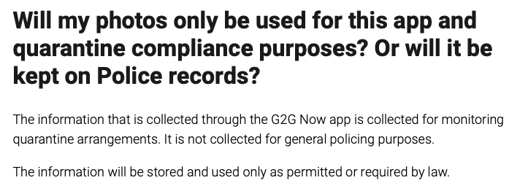
https://www.wa.gov.au/organisation/department-of-the-premier-and-cabinet/covid-19-coronavirus-g2g-now-frequently-asked-questions?fbclid=IwAR0WgFPfdYcclGzXmIzJYBn5G49lYLuhYPeo76V9byWuOFNFDKrz3nZm3oc

Slide 9
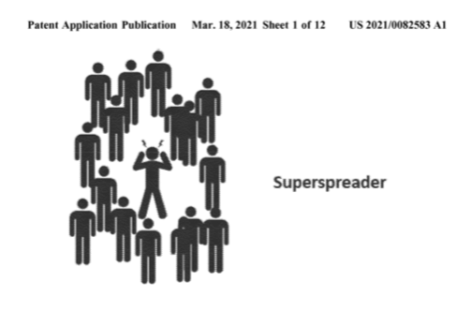
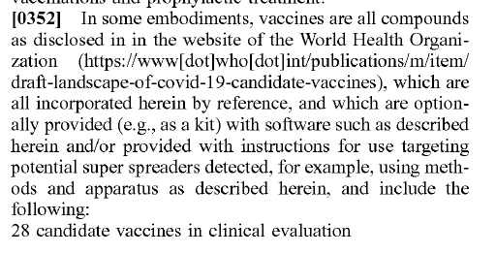
https://patentimages.storage.googleapis.com/04/24/12/7c8e8238f4ae9d/US20210082583A1.pdf

Slide 10
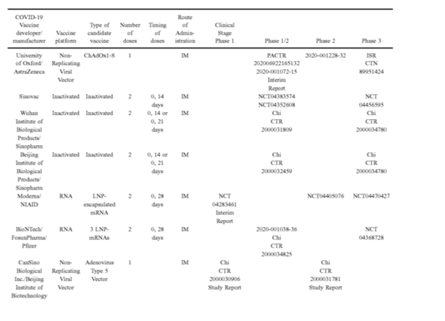
https://patentimages.storage.googleapis.com/04/24/12/7c8e8238f4ae9d/US20210082583A1.pdf

Slide 11
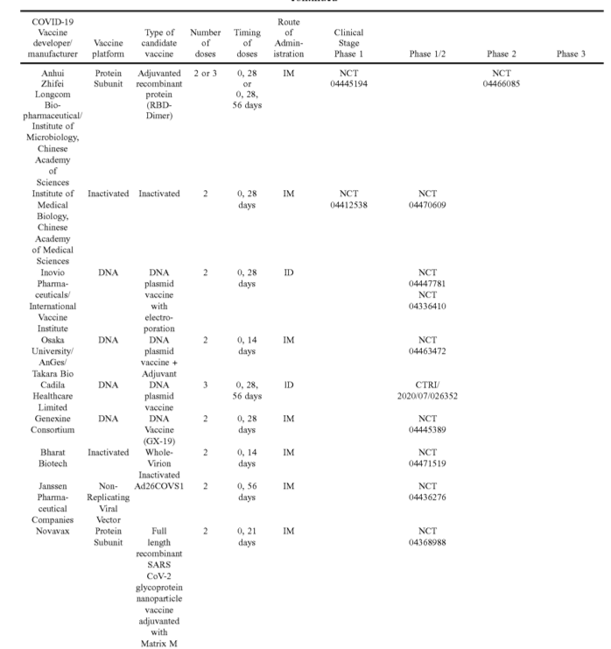
https://patentimages.storage.googleapis.com/04/24/12/7c8e8238f4ae9d/US20210082583A1.pdf

Slide 12
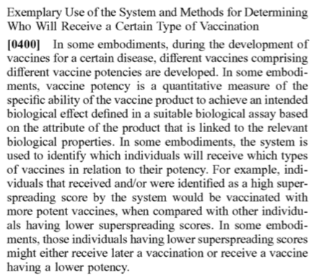
Vaccine POTENCY is
Based on Super-Spreader BEHAVIOR
https://patentimages.storage.googleapis.com/04/24/12/7c8e8238f4ae9d/US20210082583A1.pdf

Slide 13
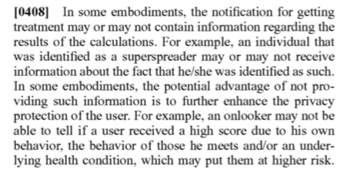
Healthcare Privacy: So private…
you may not even be informed if your health is at risk.
https://patentimages.storage.googleapis.com/04/24/12/7c8e8238f4ae9d/US20210082583A1.pdf

Slide 14
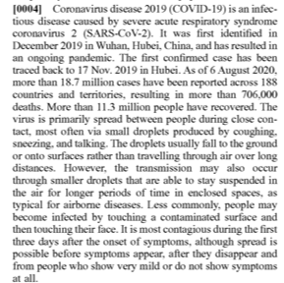

https://patentimages.storage.googleapis.com/04/24/12/7c8e8238f4ae9d/US20210082583A1.pdf

Slide 15
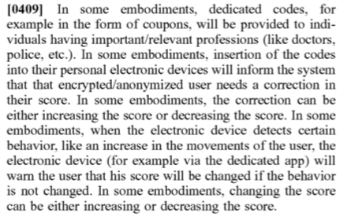
Warning Notices and
Coupon Codes
https://patentimages.storage.googleapis.com/04/24/12/7c8e8238f4ae9d/US20210082583A1.pdf

Slide 16
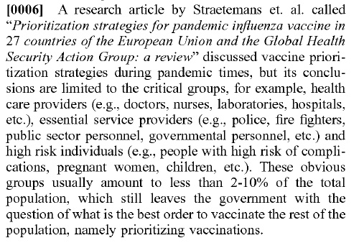
2007: Vaccine Prioritization Strategies for 27 Countries of the EU and Global Health Security Action Group:
Healthcare providers
Doctors, Nurses
Essential service providers
Police
Firefighters
Government personnel
High Risk Complications
Pregnant women
Children
https://patentimages.storage.googleapis.com/04/24/12/7c8e8238f4ae9d/US20210082583A1.pdf
https://pubmed.ncbi.nlm.nih.gov/17825095/

Slide 17



To Advance Trustworthy Ai and Prioritize Training of an Ai Ready Workforce
“We must prepare the future and the present US workforce for integration of Ai systems across all sectors of the economy and society."
“Our goal is to fill the Ai talent gap and prepare US workers for jobs of the future by implementing policies that ensure a diverse, inclusive and knowledgeable workforce. We would like to see the integration of Ai related concepts of schooling, from kindergarten, and even pre-kindergarten through doctoral positions, including community colleges…”
32:52 VIDEO START https://oecdtv.webtv-solution.com/6c38401bbfabe96c963ede85620cab98/or/Korean-delegation-AI-event-The-OECD-Principles-on-Artificial-Intelligence-Progress-over-the-Past-Two-years-and-Future-Directions.html

Slide 18

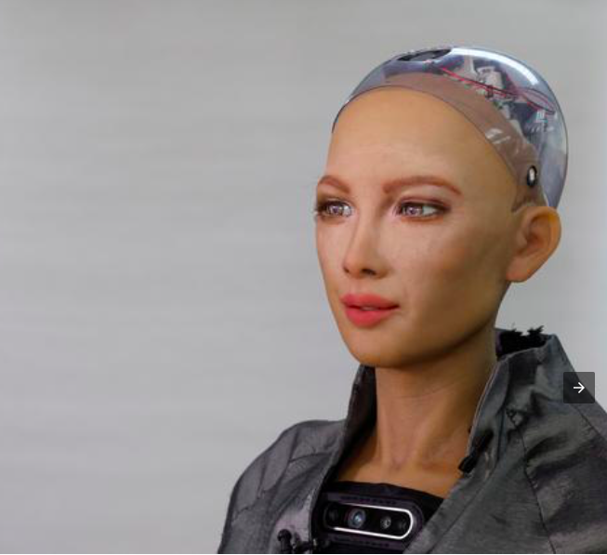
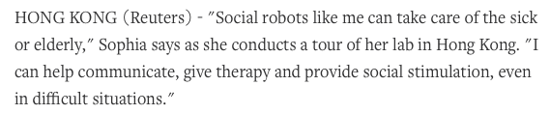
https://mobile.reuters.com/article/amp/idUSKBN29U03X?fbclid=IwAR21TWGcg0hylxQ1-gyzkG--u3LATH6d2zEc8lUuMVqE400VXYpcLERbvuI

Slide 19
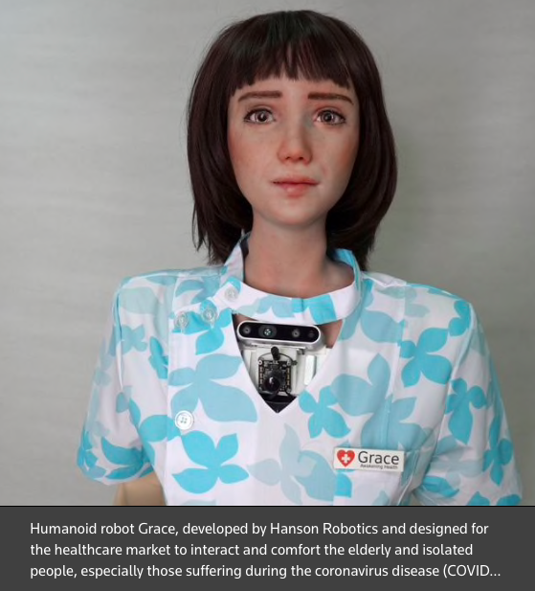
https://mobile.reuters.com/article/amp/idUSKBN29U03X?fbclid=IwAR21TWGcg0hylxQ1-gyzkG--u3LATH6d2zEc8lUuMVqE400VXYpcLERbvuI

Slide 20
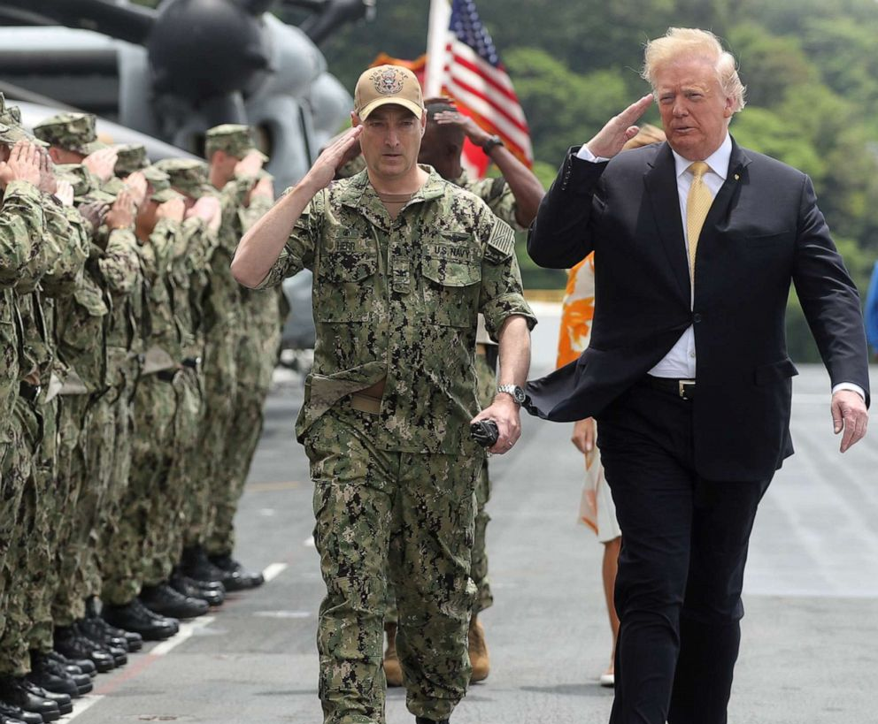

“
Have nothing to do with the fruitless deeds of darkness,
but rather expose them…
Everything exposed by the light becomes visible –
That is why it is said:
‘Wake up, sleeper,
Rise from the dead,
and Christ will shine on you.’
Be careful then on how you live – not as unwise but as wise, making the most of every opportunity because the days are evil.
”
EPHESIANS: 5: 1 - 15

